Slide 1


Linear Models
Richard Telford
EECRG, Dept. Biology
richard.telford@bio.uib.no

Slide 2
Linear Models
Describe the relationship between the response variable y and the predictor variable x
y = β₀ + β₁x
Test if terms in the model are significant
Check the method's assumptions
View the model diagnostics
Make predictions with confidence intervals

Slide 3
Linear Models
y_{i} = β₀ + β₁x_{i} + ε_{i}
y = response
x = predictor
i = 1, ..., n observations
(x_{i}, y_{i}) observation pairs
ε_{i} = error at i
β₀ = average, intercept
β₁ = effect, slope
Criteria:
y ~ N(μ,σ)
x = continuous or factor

Slide 4
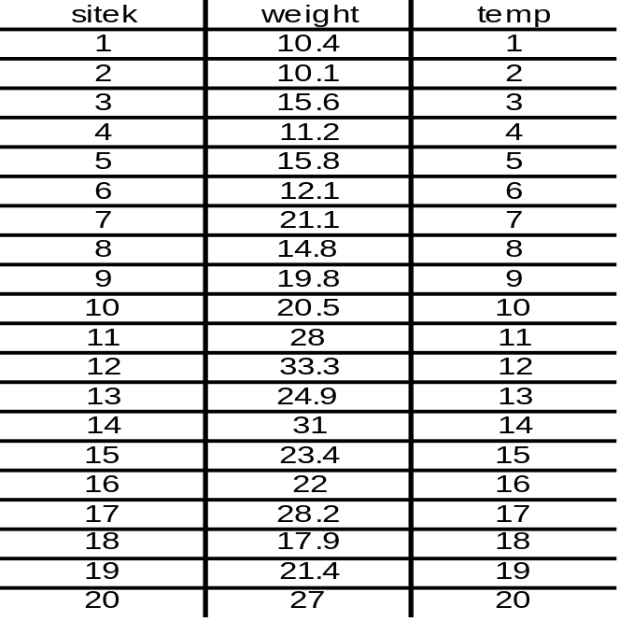
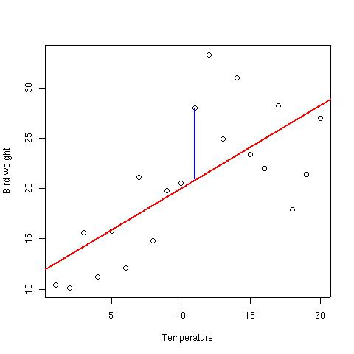
Estimating μ_{i} = β₀ + β₁x_{i}
x = temperature (continuous)
y = weight
y_{i} = μ_{i} + ε_{i}
y_{i} = μ_{i} = β₀ + β₁x_{i} + ε_{i}
β's are FIXED
ε_{i} = residuals (random)
ε_{i} = y_{i} - μ_{i}

Slide 5
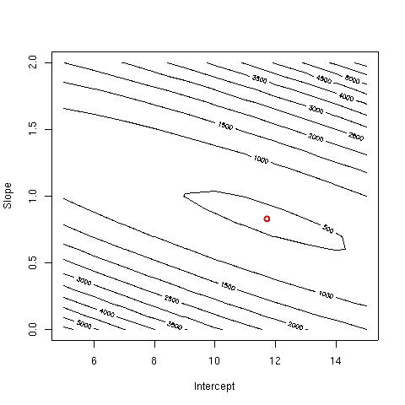
Least square residuals
y_{i} = β₀ + β₁x_{i} + ε_{i}
ε_{i} = y_{i} - (β₀ + β₁x_{i})
Q = Σε_{i}² = Σ{y_{i} - (β₀ + β₁x_{i})}²
All possible β's!
Q'(β) = 0

Slide 6
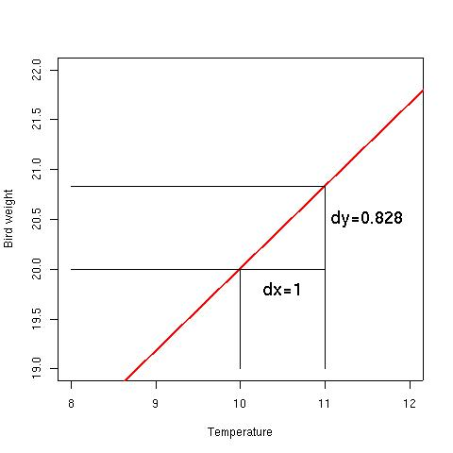
Slope & Intercept
Slope:
β₁ = Σ(x_{i} – μ_{x})(y_{i} – μ_{y}) / √(Σ(x_{i} – μ_{x})²Σ(x_{i} – μ_{x})²)
β₁ = S_{xy} / √(S_{x}²S_{x}²)
Intercept:
β₀ = μ_{y} - β₁μ_{x}

Slide 7
Interpretations
β₁ >0 increasing mean
β₁ <0 decreasing mean
y_{i} = β₀ + β₁x_{i} + ε_{i}
E(y_{i}) = ŷ_{i} = β₀ + β₁x_{i}
ε_{i} ~ N(0,σ²)

Slide 8
Is slope different from 0? (no effect)
H₀: β₁ = 0
H_{A}: β₁ ≠ 0
Use t distribution
SE(β₁) = √σ²/{Σ(x_{i} – μ_{x})²}
t_{obs} = β₁ / SE( β₁) ~ t_{α,n-p}
If t_{obs} > t_{α,n-p} then reject H₀
σ² = (n-p)⁻¹Σ(y_{i} – ŷ_{i})²
n = observations
p = parameters
n-p = degrees of freedom
α = significance level

Slide 9
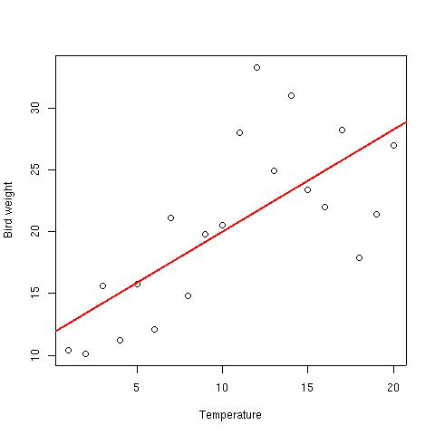
Linear Models in R
bird.df <- read.csv(“bird.csv”)
fit.lm <- lm(weight~temp, data = bird.df)
plot(bird.df$temp, bird.df$weight)
lines(bird.df$temp, fitted(fit.lm), col = ”red”)
summary(fit.lm)
Coefficients:
Estimate Std. Error t value Pr(>|t|)
(Intercept) 11.7353 2.3497 4.994 9.4e-05 ***
temp 0.8276 0.1962 4.219 0.000516 ***

Slide 10
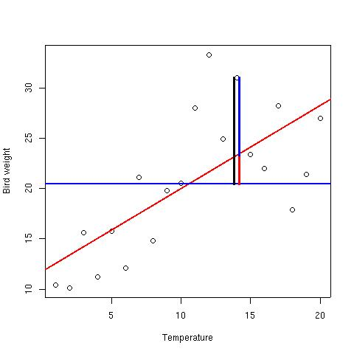
Analysis of Variance (Anova)
SStot = Σ(y_{i} – ŷ)²
SSres = Σ(y_{i} – (β₀ + β₁x_{i}))²
SSreg = Σ(β₀ + β₁x_{i} - ŷ)²
SStot = SSreg + SSres
R² = 1 – (SSres/SStot)
coefficient of determination

Slide 11
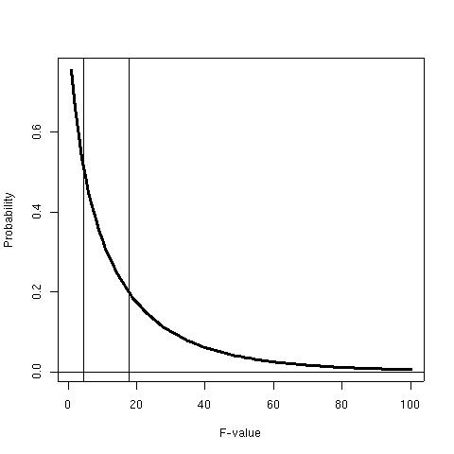
ANOVA in R
fit.lm<-lm(weight~temp)
anova(fit.lm)
Analysis of Variance Table
Response: weight
Df Sum Sq Mean Sq F value Pr(>F)
temp 1 455.47 455.47 17.801 0.0005158 ***
Residuals 18 460.55 25.59
SStot = SSreg + SSres

Slide 12
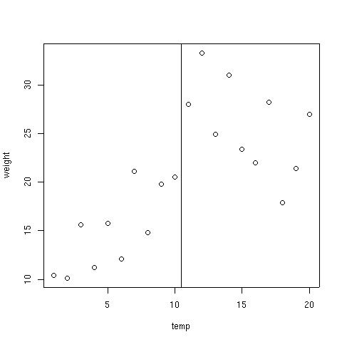
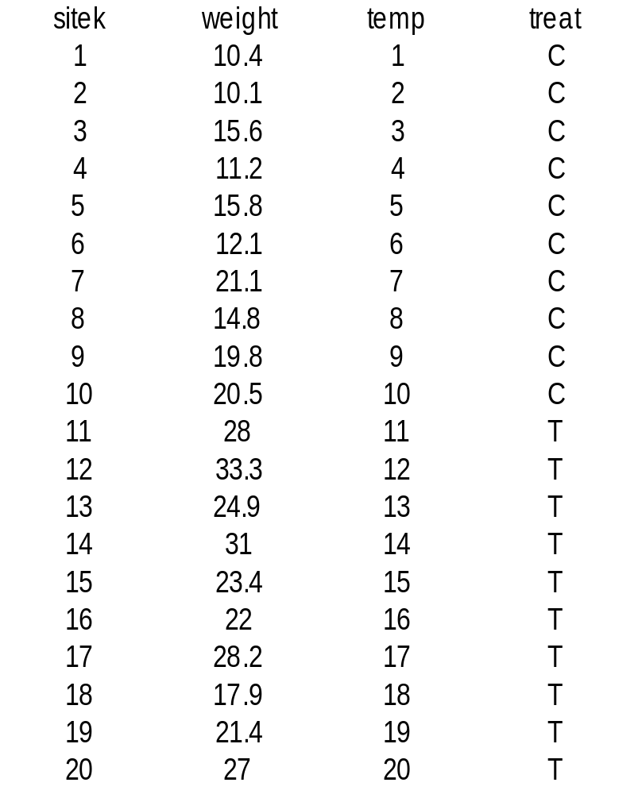
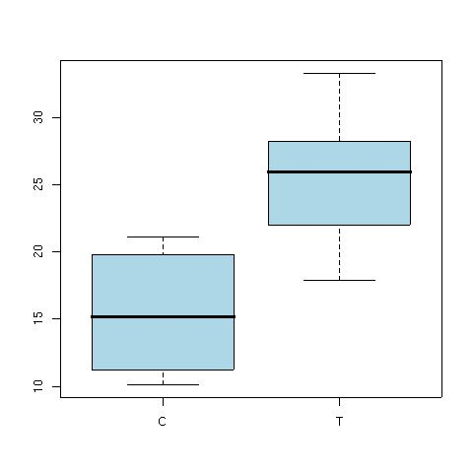
Factor variable

Slide 13
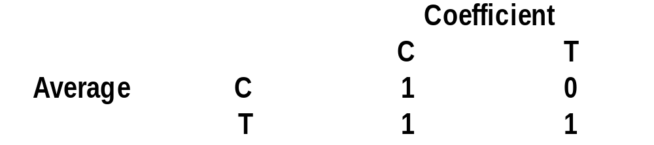
Factor
x = treat
y = weight
mean(y)
  20.4
mean(y[x==”C”])
  15.1
tapply(y,x,mean)
  15.1 25.7
y_{i} = β₀ + β₁x_{i} + ε_{i}
But,
  x = [ C, T ]
Translate into numbers
Use contrast matrix

Slide 14
Treatment contrast
If x = C:
  ŷ_{C} = β₀*1 + β₁*0
If x = T:
  ŷ_{C} = β₀*1 + β₁*1
ŷ_{i} = β₀
ŷ_{i} = β₀ + β₁x_{i}
ŷ = μ_{y}
ŷ = μ_{C} + (μ_{T} – μ_{C})x

Slide 15
Factors in R
fit.lm<-lm(weight~treat)
anova(fit.lm)
Df Sum Sq Mean Sq F value Pr(>F)
treat 1 558.62 558.62 28.135 4.829e-05
Residuals 18 357.39 19.86

Slide 16
Factors in R
summary(fit.lm)
Estimate Std. Error t value Pr(>|t|)
(Intercept) 15.140 1.409 10.745 2.92e-09
treatT 10.570 1.993 5.304 4.83e-05
ŷ_{i} = β₀ + β₁x_{i}
fit.lm$contrast
  $treat
    “contr.treatment”

Slide 17
Assumptions of least squares regression
1. The relationship between the response and the predictors is ~linear.
2. The residuals have a mean of zero.
3. The residuals have constant variance (not heteroscedastic).
4. The residuals are independent (uncorrelated).
5. The residuals are normally distributed.
Departures from these assumptions cannot be detected using the t or F statistics or R² as these statistics depend on of the assumptions.

Slide 18
Regression Diagnostics
Examining the regression diagnostics is an essential part of any regression
  Check the assumption of the model are met
  Identify outliers and influential points
Analyses are mostly based on graphical displays of the residuals
If model is appropriate, residuals should behave according to assumptions
ε_{i} = y_{i} - (β₀ + β₁x_{i})

Slide 19
Regression diagnostics
Outliers and points with high leverage can affect regression.
  Need to be identified and checked
Check assumptions of method are met
Look for indications that important predictors are missing from the model

Slide 20
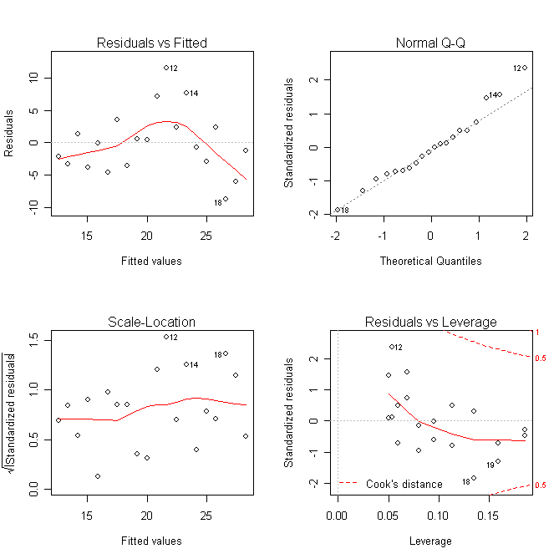
Diagnostics plots in R
fit.lm<-lm(weight~temp, data=bird1)
x11()
par(mfrow=c(2,2))
plot(fit.lm)
Four plots by default
Two more available
Use argument “which” to get specific plot

Slide 21
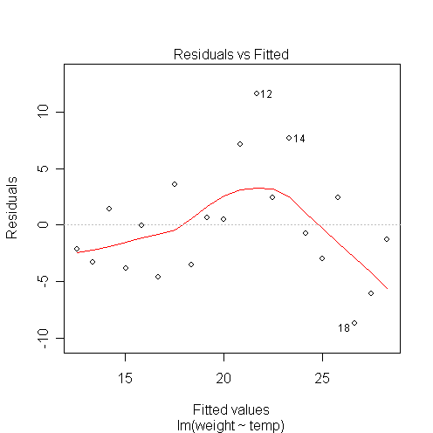
Residuals vs. Fitted
ε_{i} = y_{i} - (β₀ + β₁x_{i})
plot(fit.lm, which=1)
Visual check for
Outliers
Variations in the mean residual
Want flat line
ŷ_{i} = β₀ + β₁x_{i}

Slide 22
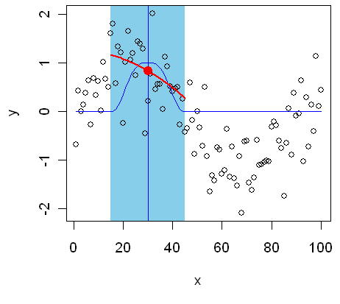
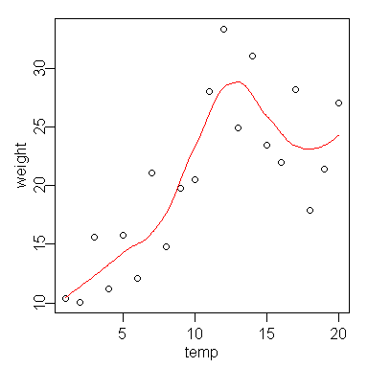
Locally Weighted Scatter Plot Smoother
LOESS or LOWESS
Local curve fitting.
Model of degree n fitted at each point
the nearest α points (set by span)
Tri-cubic weighting
fit.lo <- loess(weight~temp, span = .6,
Degree = 2, data = bird)
plot(weight~temp, data = bird)
nd<-data.frame(temp = seq(1, 20, .1))
lines(newdata$temp,
predict(fit.lo, newdata = nd), col = 2)

Slide 23
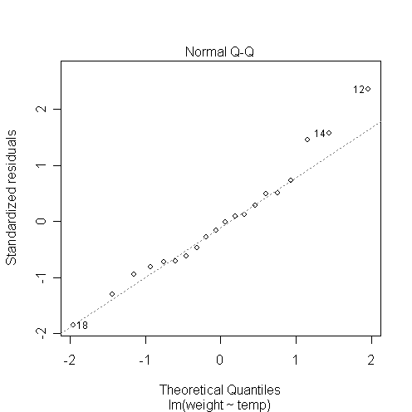
Quantile-quantile plot
QQ plots used to compare two
samples to determine if they have from the same distribution.
plot(fit.lm, which=2)
Visual check for
Non-normal distribution of the residuals
Points will lie on straight line if normally distributed

Slide 24
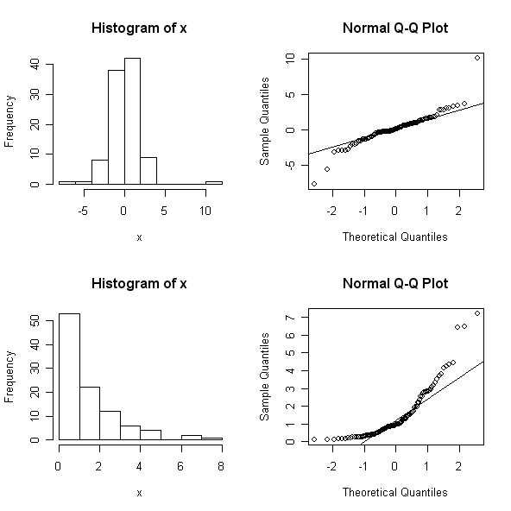
QQnorm plots
Deviations towards vertical imply long tails to the distribution
Deviations towards horizontal imply short tails
x<-rt(100,2.8)
hist(x)
qqnorm(x)
qqline(x)
x<-exp(rnorm(100,0,1))
hist(x)
qqnorm(x)
qqline(x)

Slide 25
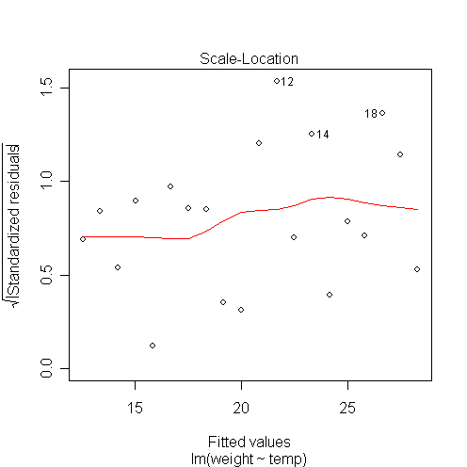
Scale-location plot
plot(fit.lm, which=3)
Square root of the absolute standardised residuals
Visual check for
Unequal variance
Heteroscedasticity
Want flat line

Slide 26
Influence and Leverage
Some observations affect the regression more than others
Leverage observations: observations remote in predictor space may not greatly influence the regression coefficients but may influence other summary statistics, such as R² and the standard errors of the coefficients
Influence observations: observations that have a marked effect on the regression coefficients
Need to identify leverage and influence observations and understand their affect on the model

Slide 27
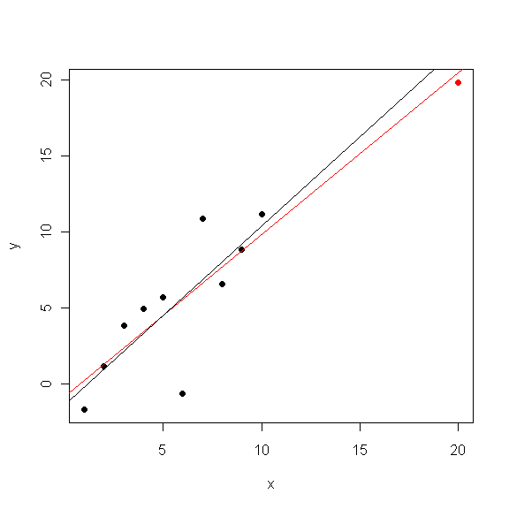
Leverage Example
Red point – high leverage
Red line – regression with red point
Black line – regression without red point
Estimate Std.Error
(Intercept) -0.8644 1.4191
x 1.0655 0.1680
---
Adjusted R-squared: 0.7969
Estimate Std.Error
(Intercept) -1.4081 1.9926
x 1.1757 0.3211
---
Adjusted R-squared: 0.5795

Slide 28
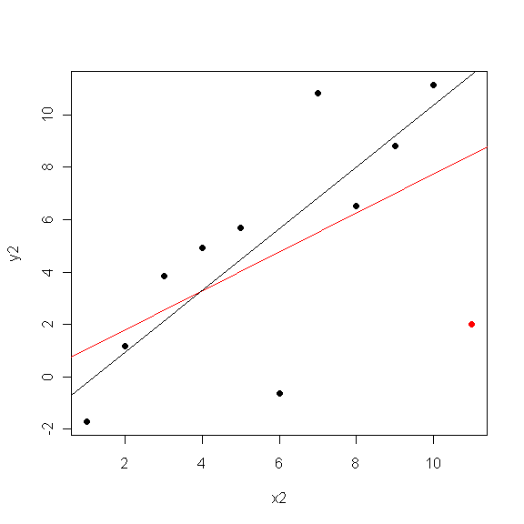
Influence Example
Red point – high influence
Red line – regression with red point
Black line – regression without red point
Estimate Std.Error
(Intercept) 0.3237 2.4570
x2 0.7428 0.3623
---
Adjusted R-squared: 0.2427
Estimate Std.Error
(Intercept) -1.4081 1.9926
x2 1.1757 0.3211
---
Adjusted R-squared: 0.5795

Slide 29
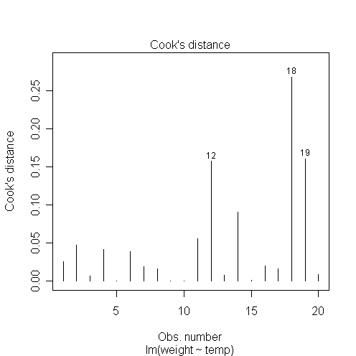
Cook’s distance
Influence of individual points on the fitted values
– how much do fitted values change when observation i removed
plot(fit.lm, which=4)
Points with a D > 4/n merit examination.
Alternative influence statistics
DFFITS – change in estimate for y_{i} when observation i removed
DFBETAS – change in coefficients when observation i removed

Slide 30
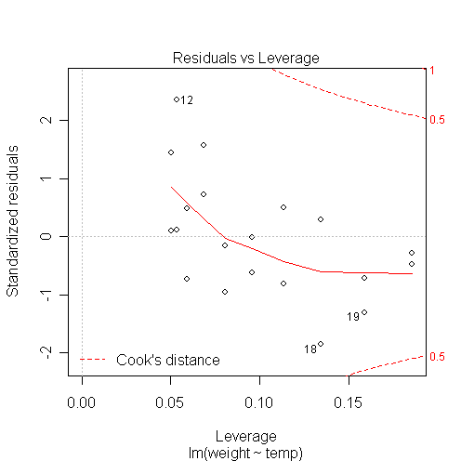
Residuals vs. Leverage
Plot of standardised residuals against leverage, with contours of Cooks distance
Observations with extreme leverage should be checked

Slide 31
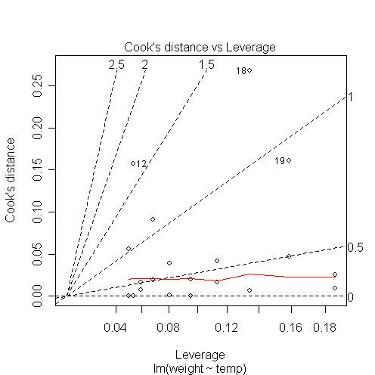
Cook’s distance vs Leverage
Influence vs leverage with contours of standardised residuals
Check extreme observations

Slide 32
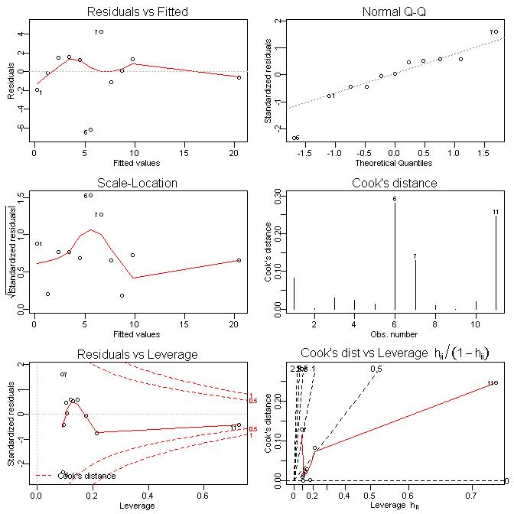
Plots with an Observation with high leverage

Slide 33
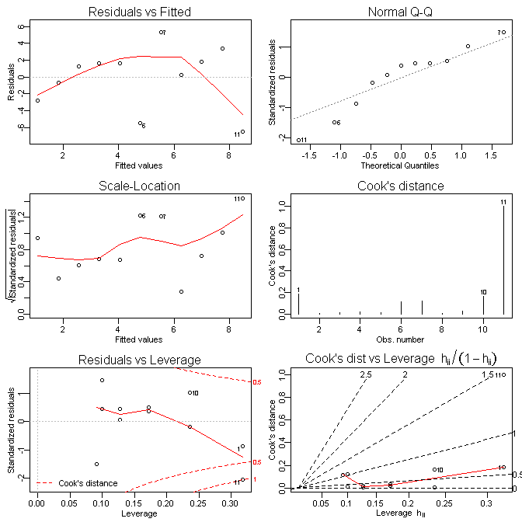
Plots with an Observation with high influence

Slide 34
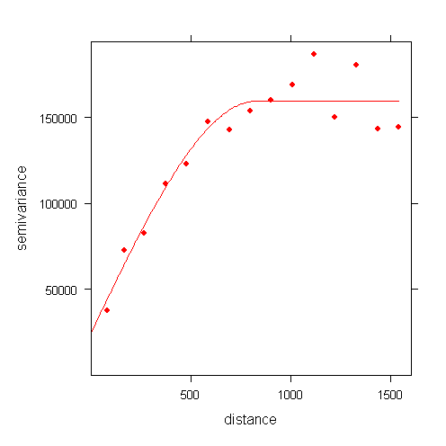
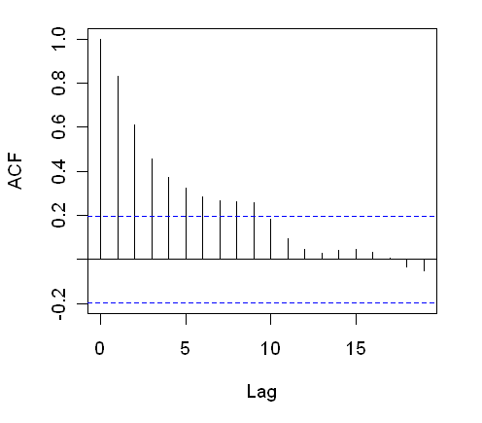
If spatial/temporal data
Check for autocorrelation with acf or variogram

Slide 35
Possible solutions
Mean residual varies from zero – consider polynomial terms in the model
Outliers – check
Non-normal distribution – consider transformations – generalised linear models
Heteroscedasticity – generalised least squares
Leverage observations – acquire more data in that region of parameter space
Influential observation - check

Slide 36
Do not casually remove outliers
Caution should be used when removing outliers from regression models
Some observations at ±3σ are expected
Removal of outliers artificially improves confidence intervals
Residuals are model specific. Correct observations may appear to be outliers if the model is wrong
Outliers may indicate other processes at work
Non-normal distribution
Always verify that outliers are not the result of transcription errors etc.

Slide 37
Syntax in R
plot(x,y) #scatter plot
fit0.lm<-lm(y~+1) #Intercept model
fit1.lm<-lm(y~x) #Effect model
anova(fit1.lm) #anova to compare model with null
anova(fit0.lm,fit1.lm) #anova to compare two models
summary(fit1.lm) #summary
lines(x,fitted(fit1.lm)) #add fitted line
plot(fit1.lm) #Diagnostic plots

Slide 38
Formula in R
Response~predictors
y~1 #intercept
y~x #effect
y~x-1 #no intercept model
y~x+z #two predictors
y~x+z+x:z #two predictors with interaction
y~x*z # ditto
y~(x+z)^2 # ditto
y~I(x^2) #protect algebra inside I()

Slide 39
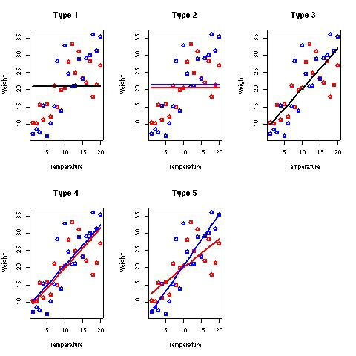
Weight vs. temperature & gender
Type 1:
  weight_{i} = β₀
Type 2:
  weight_{i} = β₀ + β₂gender_{i}
Type 3:
  weight_{i} = β₀ + β₁temp_{i}
Type 4:
weight_{i} = β₀ + β₁temp_{i} + β₂gender_{i}
Type 5:
weight_{i} = β₀ + β₁temp_{i} + β₂gender_{i} + β₃temp_{i} : gender_{i}

Slide 40
How to interpret p
Probability of obtaining a test statistic at least as extreme as that observed if the null hypothesis is true
p level chosen to designate significance is arbitrary
Does not demonstrate that alternative hypothesis is true
Non-significant results does not prove null hypothesis is true
Dependent on sample size
Probably more useful to discuss effect size and uncertainty eg slope with standard errors

Slide 41
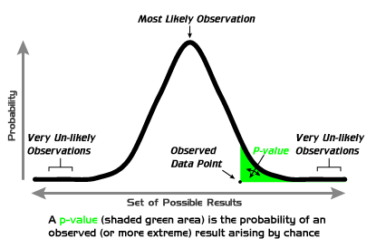
P values
Probability of getting a result at least as extreme as that observed if the null hypothesis is true
The P value is not:
the probability that the null hypothesis is true
the probability that the alternative hypothesis is false
the probability of falsely rejecting the null hypothesis.
a indication of the importance of the observed effect
P values range between 0 and 1 where 0 is very unlikely is the H₀ is true

Slide 42
Significance levels
Conventionally use p=0.05 as the arbitrary threshold of statistical significance
p=0.051 – not statistically significant
p=0.049 – statistically significant
One in twenty chance of a p-value this small by chance
No account made of the plausibility of the alternative hypothesis
Probability that mean₁=mean₂ is zero. With enough power, we can detect any effect.

Slide 43
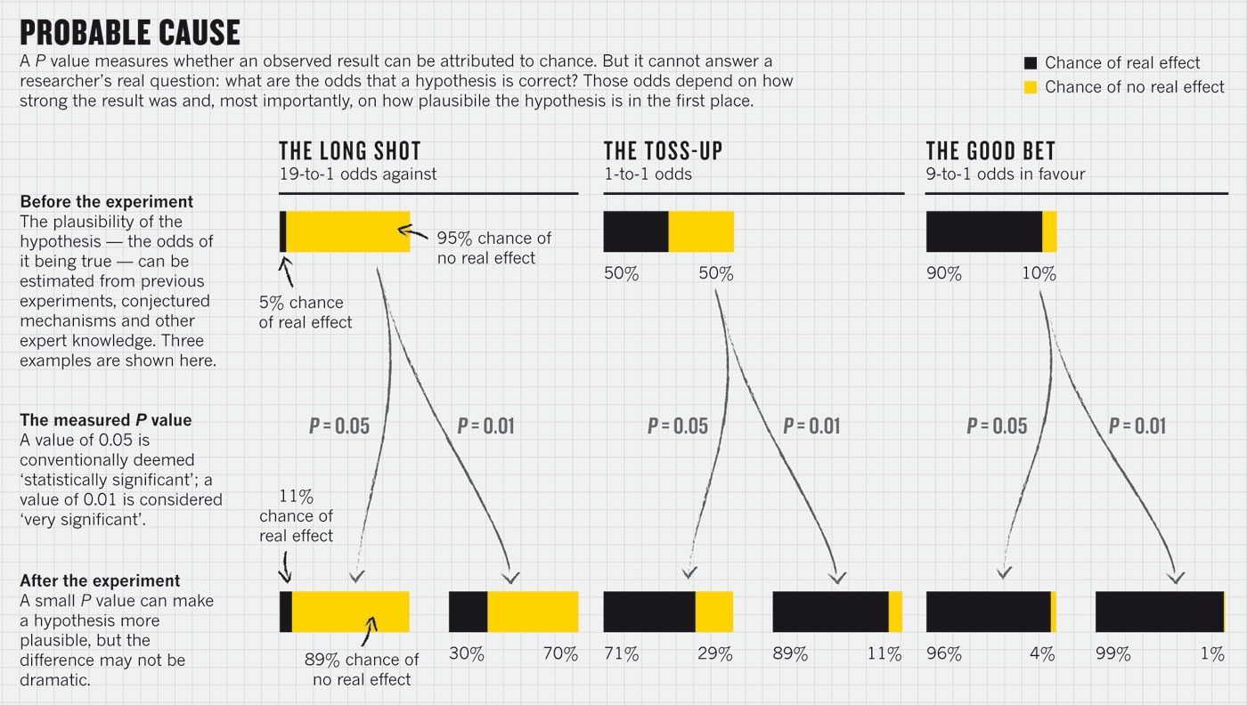
Nature 2014

Slide 44
Type I and Type II errors
 | Null hypothesis accepted | Null hypothesis rejected
Null hypothesis is true | Correct | Type I error / false positive
Null hypothesis is false | Type II error / False negative | Correct
Altering significance level changes the balance of Type I and II errors
More observations = more power = lower Type II error
Cost of Type I and II errors are subject dependent

Slide 45
Statistical Power
Larger trials have more statistical power
Lower Type II error rate
Smaller confidence intervals
But cost more
Ethical issues
Power tests allow estimation of number of observations needed to get significant result with given probability
eg power.t.test()

